Slide 1
Systèmes robotisés intelligents Smart Robotic Systems Introduction
Gilles TAGNE

Slide 2
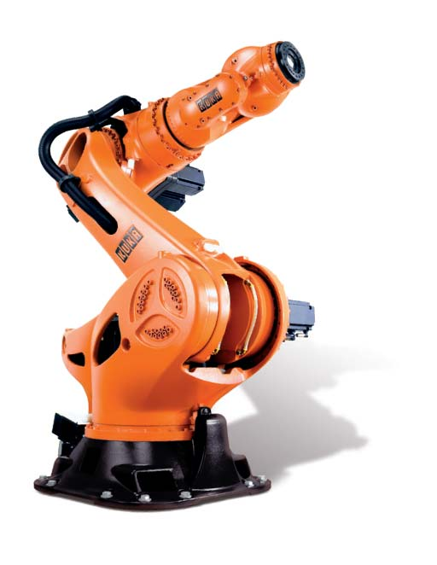
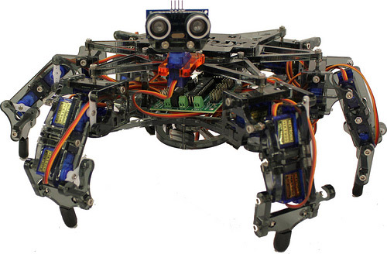
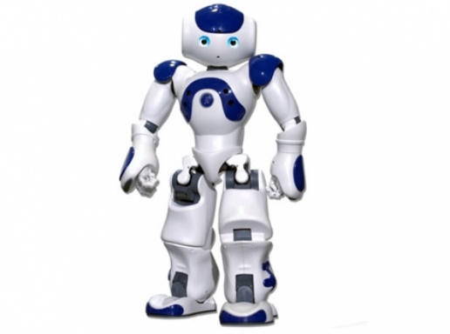
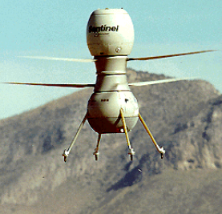
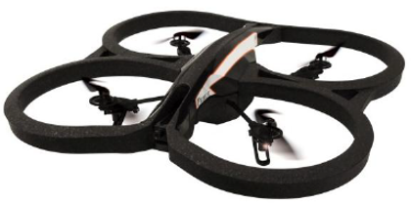
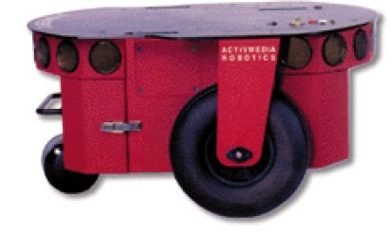
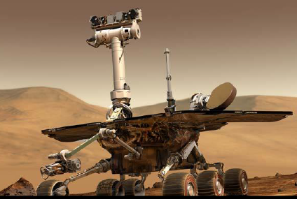
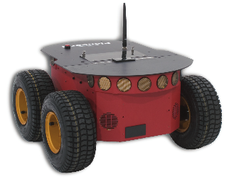
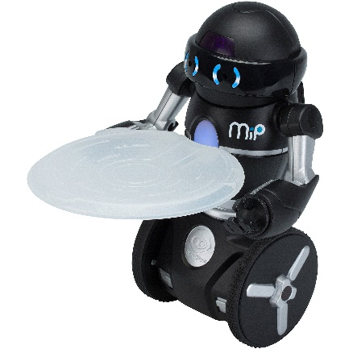
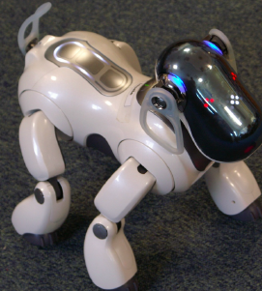
Robotics
A robot is a physical machine equipped with capacities of perception, decision and action on its environment

Slide 3
Robotics
Applications/Fieds: industrial robotics, domestic robotics, medical robotics, military robotics, scientific robotics, transportation robotics

Slide 4
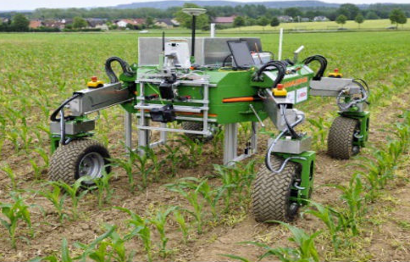
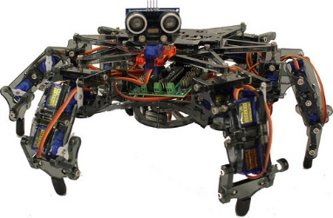
Robotics
Classifications: mobile robots, humanoid robots, medical robots, agricultural robots, …

Slide 5
Mobile robotics
Mobile robot: robot with mobile base

Slide 6
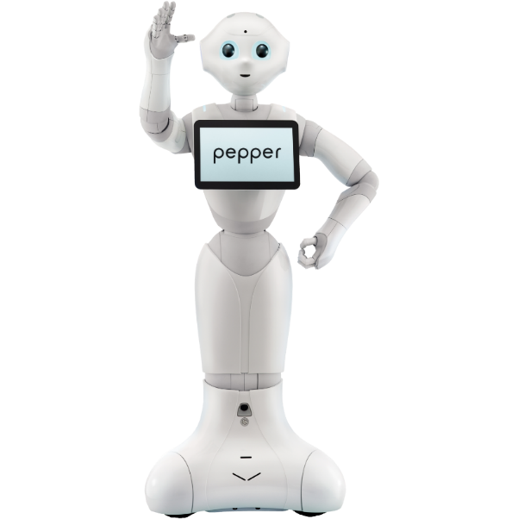
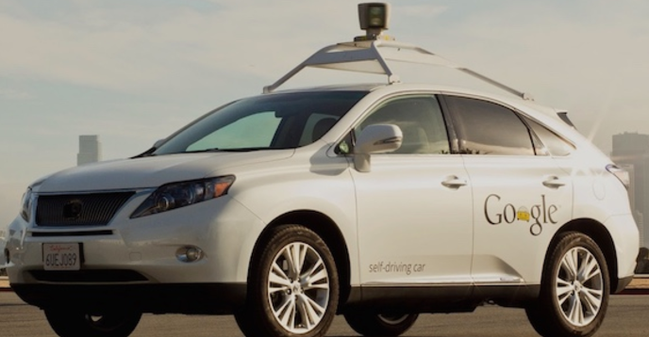
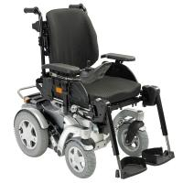
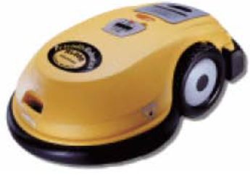
Mobile robotics
Mobile robots that will be the subject of this course:
Mobile wheeled robots
Aerial robots

Slide 7
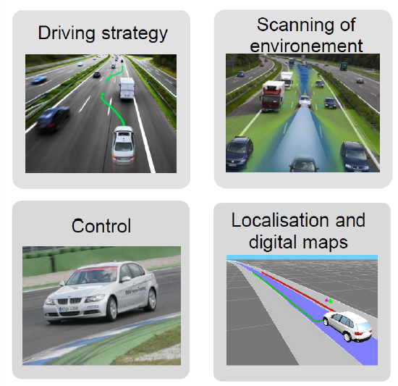
Mobile Robotics Example: Key Technologies for Intelligent Vehicles (according to Dirk Rossberg, BMW , Stanford University, 2013)

Slide 8
Mobile Robotics Main Tasks
• Localization : position the robot in its environment, which sometimes includes cartography functionalities
• Perception : detect the robot environment, navigable spaces, obstacles and ideally understand the scene
• Navigation : optimal trajectory planning for moving the robot
• Control : application of the commands on the actuators

Slide 9
Course objectives
Know how to apprehend a robotic system
Know how to model a mobile robot
Know the different technologies of perception, localization
Mastering different robot trajectory planning techniques
Plan the movements and control the robot
Design and develop a robotic system

Slide 10
Outline
Sensors and variables estimation
Sensors
Variable estimation
Multi-sensor fusion
Locomotion
Modeling of wheeled mobile robots
Modeling of aerial mobile robots
Mobile robot Localization
Mobile robot trajectory planning
Robot control
Introduction to ROS (Robot Operating System)

